Slide 1
GST bill calculator
C. Swetha
192011051
Cse

Slide 2
Project includes
Abstract
Objectives & introduction
Proposed work
Test cases
Apps & tools installation
Appium server
Implementation & testing
Test case outcomes
Conclusion

Slide 3
Abstract
GST invoice is a bill or receipt of items sent or services that a seller or service provider offers to a customer.
It specifically lists out the services/products, along with the total amount due.
One can check a GST invoice to determine said product or service prices before
CGST
SGST
are levied on them.

Slide 4
Objectives
The main goal of the gst calculator is to enable users to determine the net or gross product price on gst rates.
Display bill details: The code displays the bill details, including the person name, item name, item quantity, GST percentage, bill amount, GST amount, and total bill, which provides a clear understanding of the bill for the user.
Determine bill payment status: The code determines the bill payment status by asking if the bill has been paid and displays the status, which helps to keep track of the payment status of the bills.
User-friendly interface: The code takes inputs from the user in a user-friendly manner and displays the output in a clear and organized manner, making it easy for the user to understand.

Slide 5
Introduction
If project is used to facilitate customers to calculate the gst bill.
It is an indirect tax which has replaced many indirect taxes in india such as excise duty, vat, service taxes, etc.
Goods & services tax law in india is a comprehensive, destination-based, multistage tax that is levied on every value addition. Let us consider the following stages:
Purchase of raw materials Production or manufacture Warehousing of finished goods Selling to wholesalers Sale of the product to the retailers Selling to the end consumers

Slide 6
Proposed work
It is to develop GST bill calculator.
Run the application using Android studio emulator.
Test the application in appium software.
Appium will automate the testing of application.
Appium interacts with the application and finds out positive and negative outcomes.
Different strategies will be tested using appium.

Slide 7
Test cases
APP LAUNCH.
USER NAME.
Tax calculation.
GST rate determination.
Input validation.
Bill generation.
Multiple item billing.
PERFORMANCE.
User interface.

Slide 8



Applications used

Slide 9
Apps & Tools (appium & Android studio)
It is integrated development environment.
It has fast emulator for app testing.
It is used to develop applications for Android devices.
It automates any mobile applications from any language.
It is a open source software.

Slide 10
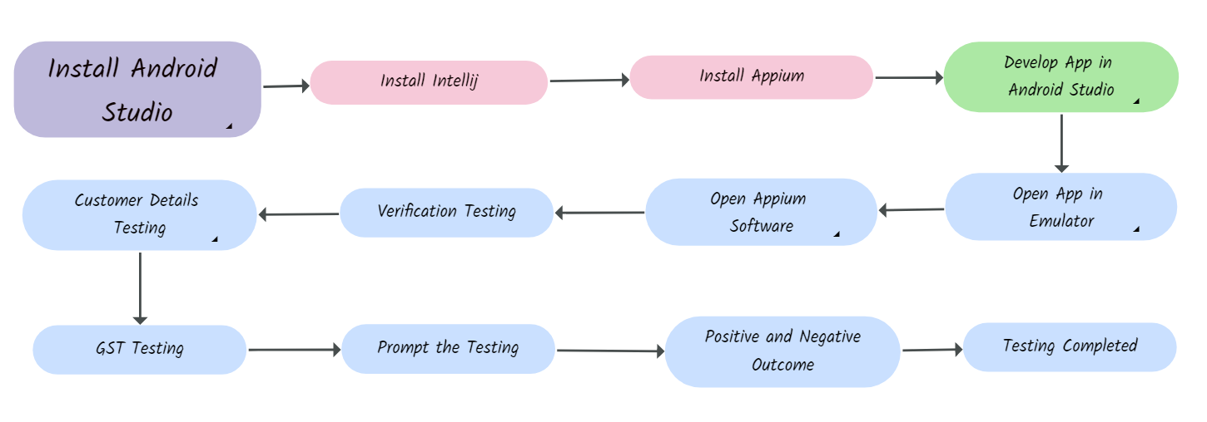
DATA FLOW DIAGRAM

Slide 11
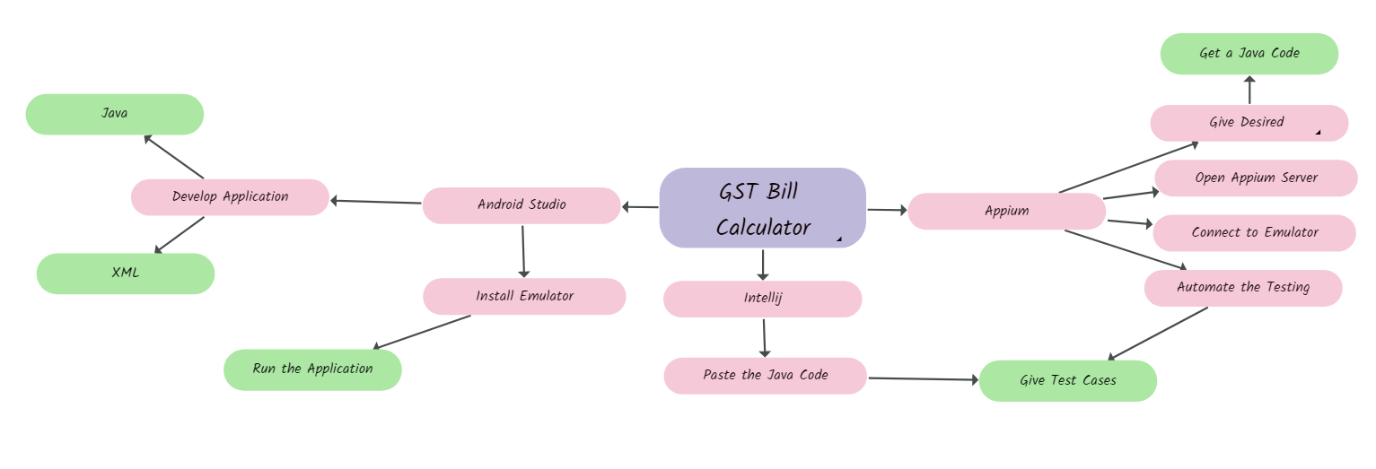
CONCEPT MAP

Slide 12
TEST CASE OUTCOMES
Tax calculation (POSITIVE)
GST rate determination (POSITIVE)
Input validation (POSITIVE)
Bill generation (POSITIVE)
Multiple item billing (POSITIVE)
PERFORMANCE (POSITIVE)
User interface (POSITIVE)

Slide 13
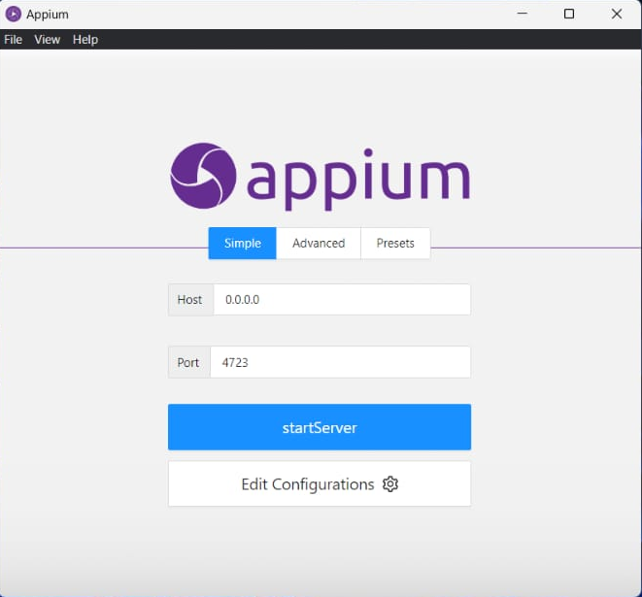
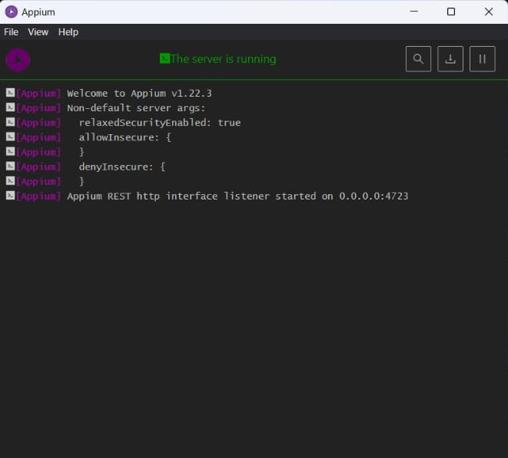
APPIUM SERVER
BEFORE STARTING SERVER
AFTER STARTING SERVER

Slide 14
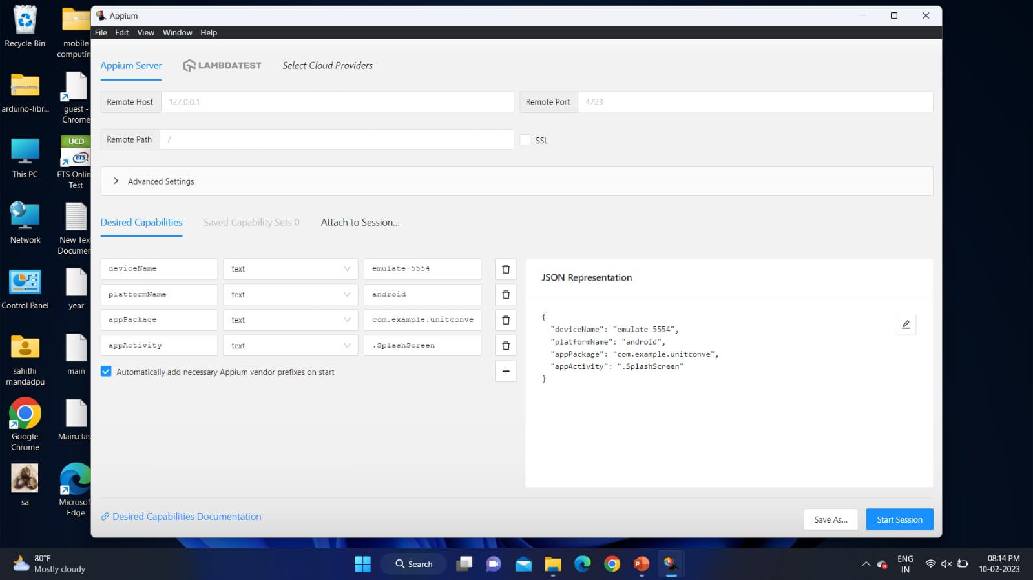
APPIUM INSPECTOR (DESIRED CAPABILITIES)
GIVE THE DESIRED CAPABILITIES IN APPIUM INSPECTOR.
IT WILL START THE SESSION AND GIVES YOU JAVA CODE TO START TESTING.
PASTE THE CODE IN intellij ide and start the testing

Slide 15
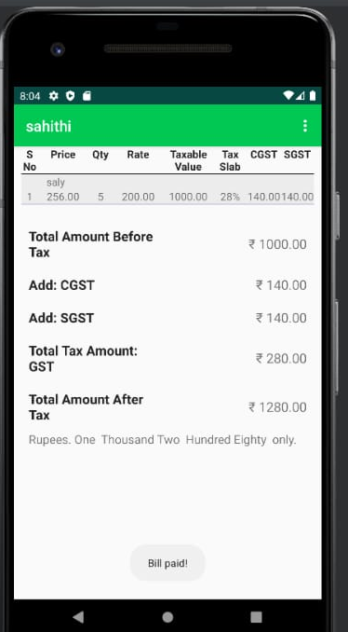
IMPLEMENTATION & TESTING

Slide 16
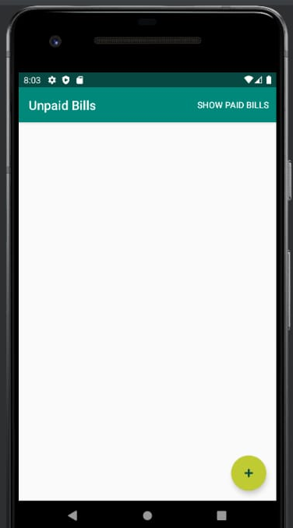
Implementation & testing

Slide 17
CONCLUSION
I CONCLUDED THAT GST HAS CERTAIN POSITIVE IMPACT LIKE ;
GST WILL ALSO HELP TO BUILD A TRANSPARENT AND CORRUPTION FREE TAX ADMINISTRATION.
THIS APP GOT 100% POSITIVE RESPONSE.
IT IS EFFICIENT AND USEFUL.

Slide 18
THANK YOU

